Slide 1
CS4104
Applied Machine Learning
Lecture No 5
Inductive Learning-III
(Decision Trees)
Spring 2025
1

Slide 2

DECISION TREES
Avoiding Over-fitting the Data: Rule Post-Pruning
2 nd Method: Rule post-pruning
1. Infer the decision tree from the training set (allowing
over-fitting to occur)
2. Convert the learned tree into an equivalent set of rules by
creating one rule for each path from the root node to a
leaf node
3. Prune (generalize) each rule by pruning any
preconditions that result in improving its estimated
accuracy
4. Sort the pruned rules by their estimated accuracy, and
consider them in this sequence when classifying
subsequent instances
1

Slide 3
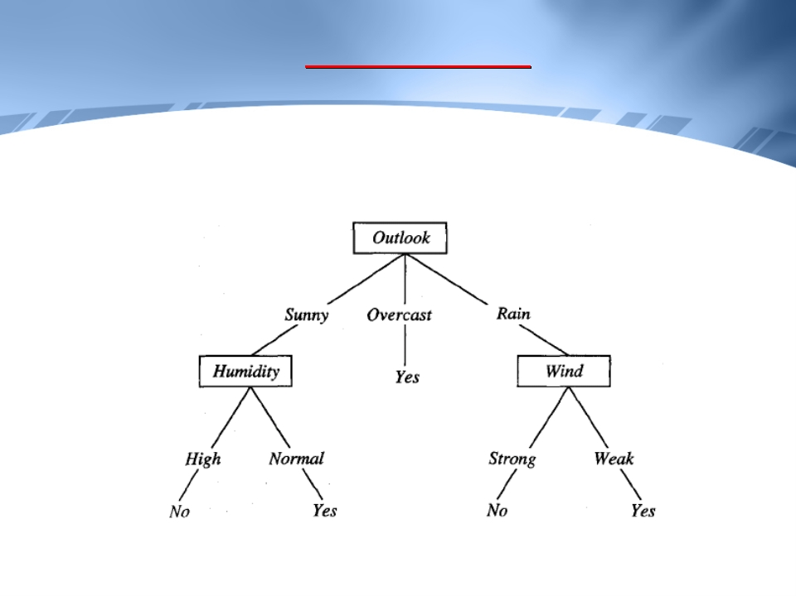
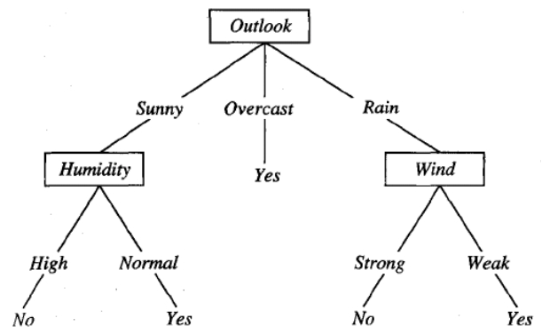
DECISION TREES
Example
2

Slide 4
DECISION TREES
Avoiding Over-fitting the Data: Rule Post-Pruning
Example:
If (Outlook = sunny) and (Humidity = high)
then Play Tennis = no
Rule post-pruning would
consider
removing
the
preconditions one by one
It would select whichever of these removals produced the
greatest improvement in estimated rule accuracy, then
consider pruning the second precondition as a further
pruning step
No pruning is done if it reduces the estimated rule accuracy
3

Slide 5
DECISION TREES
Avoiding Over-fitting the Data: Rule Post-Pruning
The main advantage of this approach:
Each distinct path through the decision tree produces a
distinct rule
Hence removing a precondition in a rule does not
mean that it has to be removed from other rules as
well
In contrast, in the previous approach, the only two
choices would be to remove the decision node
completely, or to retain it in its original form
4

Slide 6
DECISION TREES
Issues in Learning: Continuous Valued Attributes
5

Slide 7
DECISION TREES
Continuous Valued Attributes
• If an attribute has continuous values, we can dynamically
define new discrete-valued attributes that partition
the continuous attribute value into a discrete set of
intervals
• In particular, for an attribute A that is continuous
valued, the algorithm can dynamically create a new
Boolean attribute Ac that is true if A < c and false
otherwise
• The only question is how to select the best value for the
threshold c
6

Slide 8
DECISION TREES
Continuous Valued Attributes
• Example:
Let the training examples associated with a particular
node have the following values for the continuous
valued attribute Temperature and the target
attribute Play Tennis
Temperature: 40 48 60 72 80 90
Play Tennis: No No Yes Yes Yes No
7

Slide 9
DECISION TREES
Continuous Valued Attributes
• We sort the examples according to the continuous
attribute A
• Then identify adjacent examples that differ in their
target classification
• We generate a set of candidate thresholds midway
between the corresponding values of A
• These candidate thresholds can then be evaluated by
computing the information gain associated with each
8

Slide 10
DECISION TREES
Continuous Valued Attributes
• In the current example, there are two candidate
thresholds, corresponding to the values of
Temperature at which the value of Play Tennis
changes: (48 + 60)/2 and (80 + 90)/2
• The information gain is computed for each of these
attributes, Temperature > 54 and Temperature > 85,
and the best is selected (Temperature > 54)
9

Slide 11
DECISION TREES
Continuous Valued Attributes
• This dynamically created Boolean attribute can then
compete with other discrete valued candidate
attributes available for growing the decision tree
• An extension to this approach is to split the continuous
attribute into multiple intervals rather than just two
intervals (i.e. the attribute become multi-valued,
instead of Boolean)
10

Slide 12
DECISION TREES
Issues in Learning: Missing Attribute Values
11

Slide 13
DECISION TREES
Training Examples with Missing Attribute Values
• In certain cases, the available data may have some
examples with missing values for some attributes
• In such cases the missing attribute value can be
estimated based on other examples for which this
attribute has a known value
12

Slide 14
DECISION TREES
Training Examples with Missing Attribute Values
• One strategy for filling in the missing value: Assign it
the value most common for the attribute A among
training examples at node n
• Alternatively, we might assign it the most common
value among examples at node n that have the
same classification as that of the sample with missing
value
• The training example using the estimated value can
then be used directly by the decision tree learning
algorithm
13

Slide 15
DECISION TREES
Training Examples with Missing Attribute Values
• Another procedure is to assign a probability to each of
the possible values of A (rather than assigning only
the highest probability value)
• These probabilities can be estimated by observing the
frequencies of the various values of A among the
examples at node n
• For example, given a Boolean attribute A, if node n
contains six known examples with A = 1 and four with
A = 0, then we would say the probability that A(x) = 1
is 0.6 and the probability that A(x) = 0 is 0.4
14

Slide 16
DECISION TREES
Training Examples with Missing Attribute Values
• A fractional 0.6 of instance x is distributed down the
branch for A = 1, and a fractional 0.4 of x down the
other tree branch
• These fractional examples, along with other “integer”
examples are used for the purpose of computing
information Gain
• This method for handling missing attribute values is
used in C4.5
15

Slide 17
DECISION TREES
Classification of Instances with Missing Attribute Values
• The fractioning of examples can also be applied to
classify new instances whose attribute values are
unknown
• In this case, the classification of the new instance is
simply the most probable classification, computed by
summing the weights of the instance fragments
classified in different ways at the leaf nodes of the tree
16

Slide 18
DECISION TREES
Issues in Learning: Attributes with Different Costs
17

Slide 19
DECISION TREES
Handling Attributes with Differing Costs
• In some learning tasks, the attributes may have
associated costs. For example, we may have attributes
such as Temperature, Biopsy Result, Pulse, Blood
Test Result, etc.
• These attributes vary significantly in their costs
(monetary costs, patient comfort, time involved)
• In such tasks, we would prefer decision trees that use
low-cost attributes where possible, relying on high
cost attributes only when needed to provide reliable
classifications
18

Slide 20
DECISION TREES
Handling Attributes with Differing Costs
• In ID3, attribute costs can be taken into account by
introducing a cost term into the attribute selection
measure
• For example, we might divide the Gain by the cost of the
attribute, so that lower-cost attributes would be
preferred
• Such cost-sensitive measures do not guarantee
finding an optimal cost-sensitive decision tree.
However, they do bias the search in favor of low cost
attributes
19

Slide 21
DECISION TREES
Handling Attributes with Differing Costs
• Another example of selection measure is:
Gain 2 (S,A) / Cost(A)
where S = collection of examples & A = attribute
• Yet another selection measure can be
2 Gain (S,A) – 1 / {Cost(A) + 1} w
where w ∈ [0, 1] is a constant that determines the
relative importance of cost versus information gain
20

Slide 22
DECISION TREES
Issues in Learning: Alternate Selection Measures
21

Slide 23
DECISION TREES
Alternate Measures for Selecting Attributes
• There is a problem in the information gain measure. It
favors attributes with many values over those with few
values
• Example: An attribute “Date” would have the highest
information gain (as it would alone perfectly fit the
training data)
• To cushion this problem the Info. Gain is divided by a
term called “Split Info”
22

Slide 24
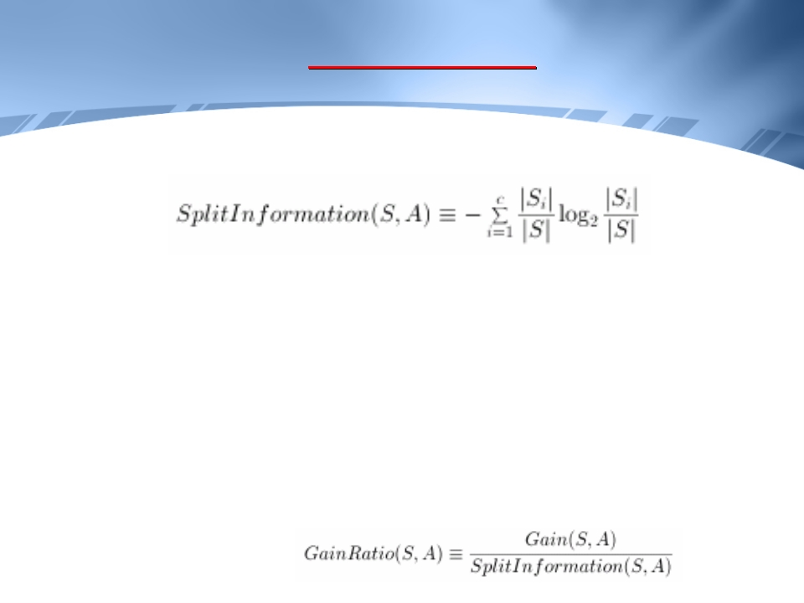


DECISION TREES
Alternate Measures for Selecting Attributes
where Si is the subset of S for which A has value vi
Note that the attribute A can take on c different values,
e.g. if A = Outlook,
then v1 = Sunny, v2 = Rain, v3 = Overcast
When divided by Split Information the measure is called
Gain Ratio
23

Slide 25
DECISION TREES
Alternate Measures for Selecting Attributes
• Example:
Let there be 100 training examples at a node A1, with
100 branches (one sliding down each branch)
Split Info (S, A1) = - 100 * 1/100 * log2 (0.01)
= log2(100) = 6.64
Let there 100 training examples at a node A2, with 2
branches (50 sliding down each branch)
Split Info (S, A2) = - 2 * 50/100 * log2 (0.5) = 1
24

Slide 26
DECISION TREES
Alternate Measures for Selecting Attributes
• Problem with this Solution!!!
The denominator can be zero or very small when
Si ≈ S
for one of the Si
To avoid selecting attributes purely on this basis, we
can adopt some heuristic such as first calculating the
Gain of each attribute, then applying the Gain Ratio
test only those considering those attributes with above
average Gain
25

Slide 27
DECISION TREES
Conclusion
26

Slide 28
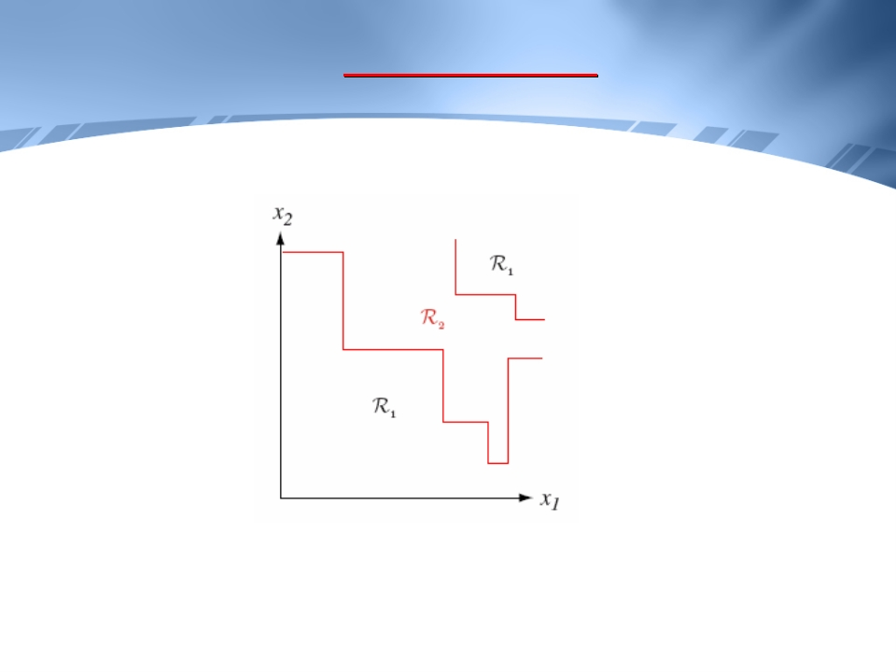
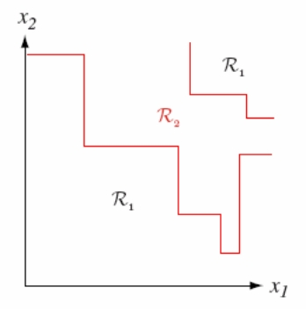
DECISION TREES
Decision Boundaries
27

Slide 29
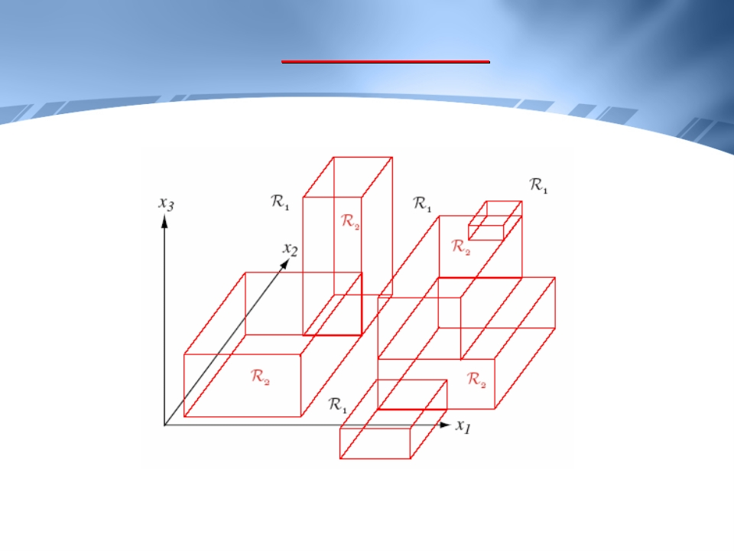
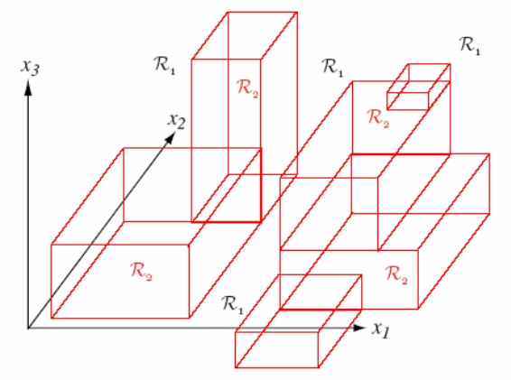
DECISION TREES
Decision Boundaries
28

Slide 30
DECISION TREES
Advantages
• Easy Interpretation: They reveal relationships between
the rules, which can be derived from the tree. Because
of this it is easy to see the structure of the data.
• We can occasionally get clear interpretations of the
categories (classes) themselves from the disjunction of
rules produced, e.g. Apple = (green AND medium) OR
(red AND medium)
29

Slide 31
DECISION TREES
Advantages
• Classification is rapid & computationally inexpensive
• Trees provide a natural way to incorporate prior
knowledge from human experts
30

Slide 32
DECISION TREES
Disadvantages
•
•
•
They may generate very complex (long) rules, which
are very hard to prune
They generate large number of rules. Their number
can become excessively large unless some pruning
techniques are used to make them more
comprehensible.
They require big amounts of memory to store the
entire tree for deriving the rules.
31

Slide 33
DECISION TREES
Disadvantages
•
•
They do not easily support incremental learning.
Although ID3 would still work if examples are
supplied one at a time, but it would grow a new
decision tree from scratch every time a new example
is given
There may be portions of concept space which are not
labeled
e.g. If low income and bad credit history then high
risk
but what about low income and good credit history?
32

Slide 34
DECISION TREES
Appropriate Problems for Decision Tree Learning
• Instances are represented by discrete attribute-value pairs
(though the basic algorithm was extended to real-valued
attributes as well)
• The target function has discrete output values
• Disjunctive hypothesis descriptions may be required
• The training data may contain errors
• The training data may contain missing attribute values
33

Slide 35
DECISION TREES
Reference
Sections 3.5, 3.6, 3.7.1
Sections 3.7.1, 3.7.2, 3.7.3, 3.7.5
Sections 3.3, 3.7.4
of T. Mitchell
of T. Mitchell
of T. Mitchell
34

